Slide 1
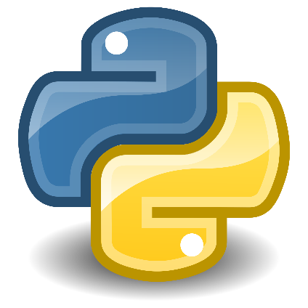


Class: IX Lab: 12
Python
Dictionary

Slide 2



Dictionary
A dictionary is a collection
which is unordered,
changeable and indexed.
In Python dictionaries are
written with curly brackets,
and they have keys and values.

Slide 3
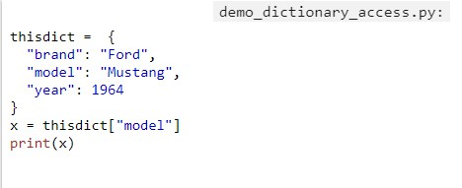
Accessing Items
Add keys and its values in a variable
Starting with a curly bracket
To declare a dictionary

Slide 4
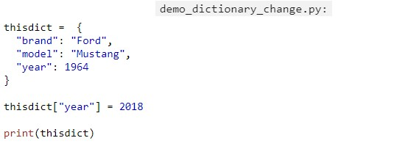
Change Values
You can change any value from the dictionary

Slide 5
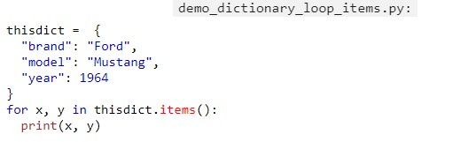
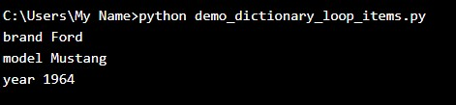
Loop Through Dictionary
Loop by Items

Slide 6
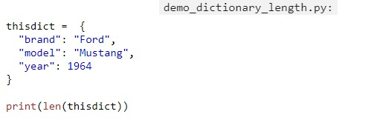

Dictionary Length
You can check the length of your dictionary

Slide 7
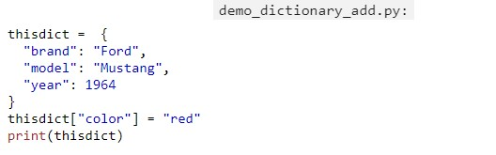

Adding New Items
You can add
new items to the
dictionary

Slide 8
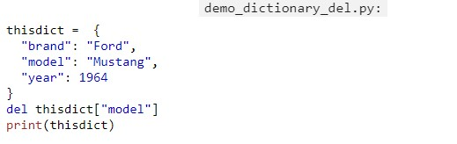

Removing Items
Use del function to delete any value.
There are also some other ways to remove. Check your lecture note

Slide 9
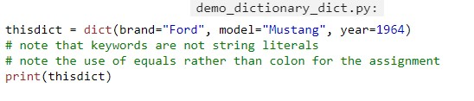

Construct Dictionary
You can use dict function also to create a dictionary

Slide 10
